Slide 1

AWS Cloud Virtual Internship
by
B.SWAROOPA
Roll No. 214G1A32B1
Department of Computer Science and Engineering (Data Science)
Srinivasa Ramanujan Institute of Technology
(Affiliated to JNTUA & Approved by AICTE) (Accredited by NAAC with ‘A’ Grade & Accredited by NBA (EEE, ECE & CSE)
Rotarypuram Village, B K Samudram Mandal, Ananthapuramu – 515701.
2023 - 2024

Slide 2

Contents
Course Objective
Introduction
Technology
Applications
Modules
Real Time applications
Learning outcomes
GitHub Link
Queries

Slide 3
Course Objective
The main objective of AWS Cloud Virtual Internship is to gain a thorough understanding of various AWS services and their roles in cloud-based solutions.
Apply best practices and design patterns in cloud architecture through hands-on projects and case studies.

Slide 4
Introduction
Amazon Web Services Cloud (AWS) :
Amazon Web Services (AWS) is a comprehensive and widely adopted cloud platform offering over 200 fully-featured services from data centers globally.
AWS Cloud, refers to the suite of cloud computing services provided by Amazon. It offers a comprehensive set of infrastructure services, such as computing power, storage options, and networking capabilities, delivered over the internet on a pay-as-you-go pricing model.
AWS Cloud empowers organizations to build
sophisticated applications with increased flexibility,
scalability, and reliability.

Slide 5
Technologies
These technologies and services form the backbone of AWS, enabling businesses to build, deploy, and manage applications in a highly scalable and flexible cloud environment.
Amazon S3: Scalable object storage service offering secure, durable, and cost-effective storage for any data.
AWS CloudFormation: Infrastructure as Code (IaC) service allowing easy modeling and provisioning of AWS resources.
Amazon EC2: Provides scalable virtual servers, allowing flexible computing capacity on demand for various applications.
Amazon VPC: Virtual Private Cloud service enabling isolated network environments within the AWS cloud for secure operations.
Amazon EBS: Block storage service designed for use with EC2, providing persistent and highly available storage.

Slide 6
Applications
AWS Cloud offers a broad range of applications across various industries due to its scalable, reliable, and flexible services. Here are some key applications:
Backup and Disaster Recovery: Securely backup data and ensure business continuity with services like Amazon S3, Glacier, and AWS Backup.
Content Delivery: Distribute content globally with low latency using Amazon CloudFront, a fast content delivery network (CDN).
Internet of Things (IoT): Connect and manage IoT devices with AWS IoT Core, IoT Analytics, and Greengrass for edge computing.
Web Hosting: Host websites and web applications with scalable resources and high availability using services like Amazon EC2, S3, and Route 53.
Big Data Analytics: Process and analyze large datasets using tools like Amazon EMR, Redshift, Kinesis, and AWS Glue for ETL.

Slide 7
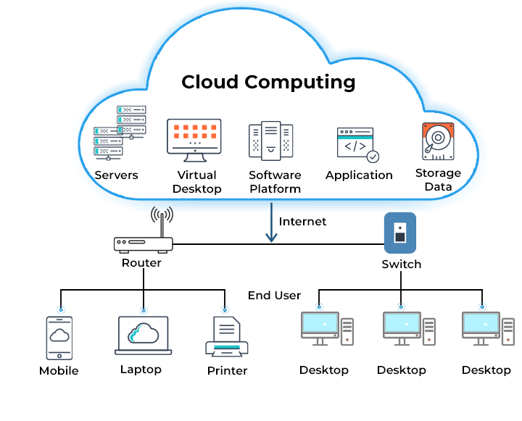
Modules
AWS Cloud Architecture :
AWS Cloud architecture is a process of
planning, designing, and implementing AWS
resources in a cloud infrastructure. Various
AWS resources connect in a structured
way that allows data to flow seamlessly.

Slide 8
Cont…
The cloud computing architecture shows a typical setup where cloud services(servers, virtual desktops, software platforms, applications, and data storage) are hosted remotely. These services are accessed over the internet, with a router providing connectivity to end-user devices.
The switch facilitates connections within a local network, enabling multiple devices like mobiles, laptops, printers, and desktops to communicate with the cloud. This setup allows users to access and utilize cloud resources seamlessly, regardless of their physical location, promoting efficiency, scalability, and flexibility in resource usage.

Slide 9
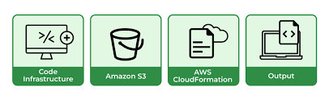
AWS Cloud Formation
Amazon Web Services(AWS) offers cloud formation as a service by which you can provision and manage complicated services offered by AWS by using the code. Cloud formation will help you to manage the infrastructure and the services in the form of a declarative way.
Amazon Web Services (AWS) is the service offered by the AWS cloud it is mainly used to provision the service in the AWS like EC2, S3, Autoscaling, load balancing and so on you can provision all the service automation with the Infrastructure as a code (IAC), instead of managing all of them manually you can manage with the help of AWS Cloud formation.

Slide 10
Cont..
Basic Workflow:
Write a Template: Define the desired resources and their configurations in a JSON or YAML file.
Create a Stack: Use the AWS Management Console, AWS CLI, or AWS SDKs to create a stack based on the template. AWS CloudFormation will provision the resources specified in the template.
Update the Stack: If you need to change your infrastructure, update the template and then update the stack. AWS CloudFormation will handle the changes.
Delete the Stack: When the stack is no longer needed, delete it, and AWS CloudFormation will delete all the resources associated with it.

Slide 11
Cont…
Benefits:
Consistency: Ensures that resources are created and configured in a consistent manner.
Automation: Automates the process of resource provisioning and management.
Version Control: Templates can be version-controlled, enabling better management of infrastructure changes.
Efficiency: Reduces the time and effort required to set up and manage infrastructure.
Cost savings: AWS CloudFormation helps to reduce costs by allowing customers to use existing infrastructure templates and reuse them across multiple environments.
Security: AWS CloudFormation helps to ensure that all AWS resources are configured securely by using security policies and rules. This helps to protect the infrastructure from potential security threats.

Slide 12
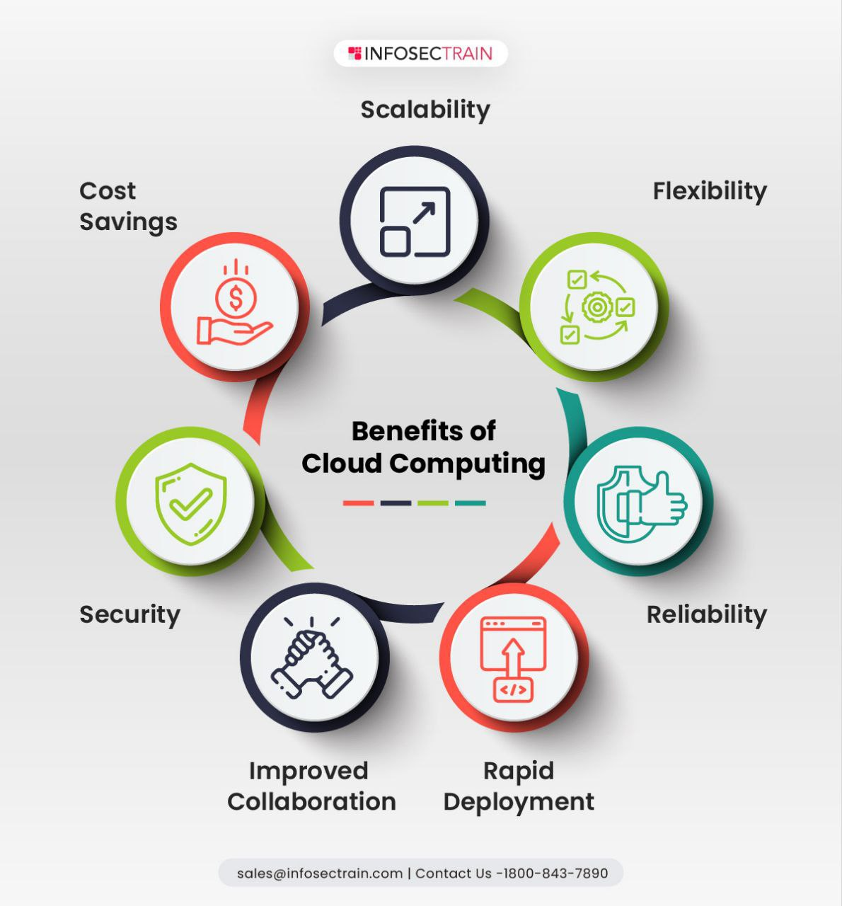
Cont…

Slide 13
Database Services
AWS offers a wide range of database services . The service fall into two groups: relational and non-relational (NoSQL).
AWS Relational Database Services :
Relational databases store data in tabular form with columns and rows, and can be queried using the SQL query language. In these databases, columns represent attributes and rows represent records. Each field in the table is a data value. The primary Amazon services providing relational databases are:
Amazon Aurora
Amazon RDS
Amazon Redshift

Slide 14
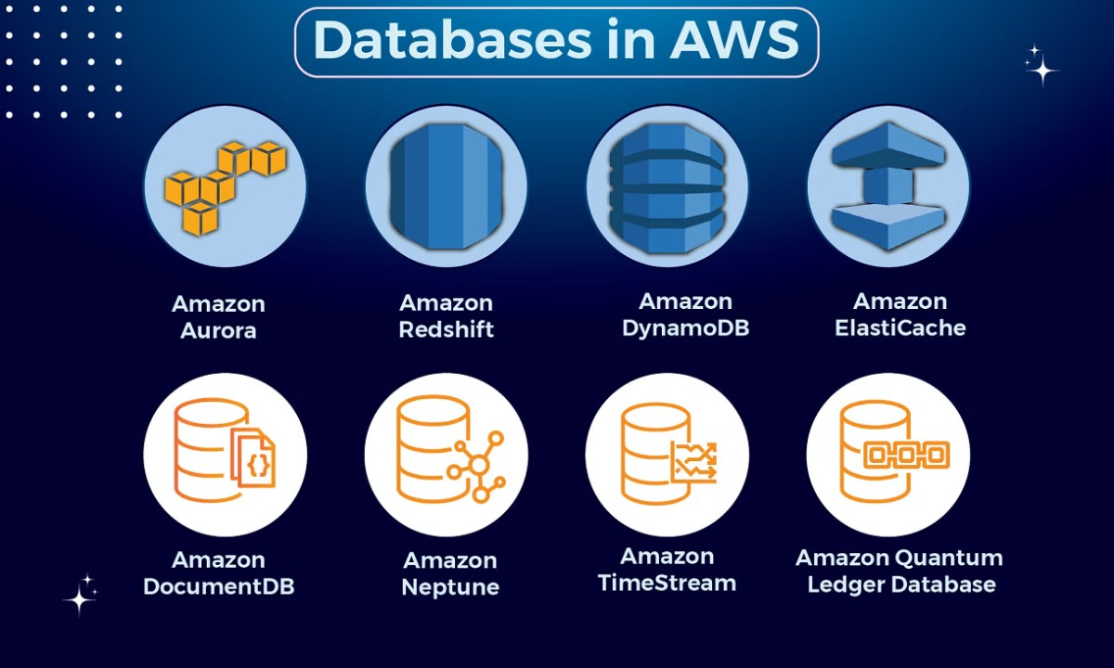
Cont….
AWS NoSQL Database Services :
Relational databases are not suitable for many use cases, especially those requiring very high performance or dynamic scalability. NoSQL, or non-relational databases, break the paradigm of storing data in tables with columns and rows, allowing them to distribute and process data more efficiently. NoSQL is commonly used to handle big data large volumes of unstructured or semi-structured data.

Slide 15
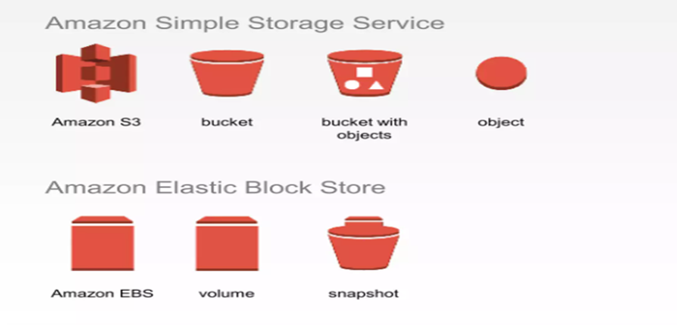
Storage Services
Amazon S3 and Amazon EBS are both storage services provided by AWS, but they serve different purposes and are optimized for different use cases.
Amazon S3 (Simple Storage Service)
Amazon S3 is an object storage service designed for storing and retrieving large amounts of data from anywhere on the web.
Amazon EBS:
Amazon EBS (Elastic Block Store) is a
scalable, high-performance block storage service
designed for use with Amazon EC2(Elastic Compute
Cloud) instances. It provides persistent storage that
remains available even when EC2 instances are
stopped or terminated.

Slide 16
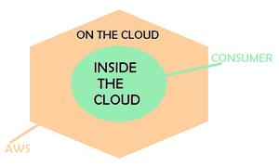
Security Model of AWS Cloud
The security model of the AWS cloud aims to deliver Confidentiality, Availability, and Integrity of data. It is been said that Cloud computing is secure and AWS provides complete data protection. Amazon cloud services use a special security model termed as a shared security model. It is also known as the Shared responsibility model.
The shared security model of AWS makes sure that both the AWS and customer using their cloud service should be equally responsible for securing the data on the cloud. In this model, Amazon takes responsibility to secure the cloud infrastructure and the customer’s responsibility is to secure the deployed application and related workload.

Slide 17
Cont….
Role of AWS :
AWS secures the global infrastructure of the cloud. This global infrastructure consists of the hardware and software, i.e. the physical level security. AWS also manages the availability zones and edge locations.
Network Security with built-in firewalls, DDoS Mitigation, and TLS.
Monitor activities and logs.
Role of customer :
Different customers have different responsibilities as it depends on the type of service they are using.
The logical configuration of services needs to be done from the client-side.
Setting up accounts with Strong credentials.

Slide 18
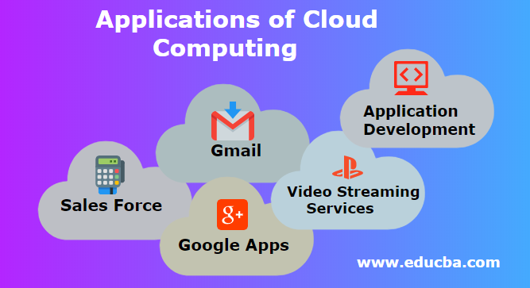
Real Time Applications
Data Processing and Analytics
Internet Of Things
Data Storage
Big Data and Data Warehousing
E-commerce and Retail Solutions
Disaster Recovery and Backup
Application Development

Slide 19
Learning Outcomes
Understanding of AWS Cloud Architecture & its benefits.
Learnt about the Security Model provided by AWS Cloud.
Easily understandable about the AWS Cloud Formation.
It’s applications in real time.

Slide 20
Any Queries?

Slide 21
Thank You!!!

